Slide 1
German Credit Data
Pattern Recognition & Machine Learning Laboratory
Han-Seul Jeong
January 17, 2019

Slide 2
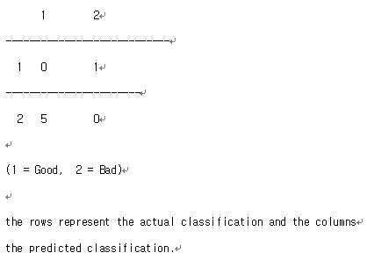
Overall description
German Credit Data
Source
Professor Dr. Hans Hofmann Institut f"ur Statistik und "Okonometrie Universit"at Hamburg FB Wirtschaftswissenschaften Von-Melle-Park 5 2000 Hamburg 13
Instances
1000개
Attributes
A : 20개 (7 numerical, 13 categorical)
B : 24개 (24 numerical)
Format
A : .data, B : .data-numeric
Additional Info
Cost matrix
Cost matrix
http://archive.ics.uci.edu/ml/datasets/statlog+(german+credit+data)

Slide 3
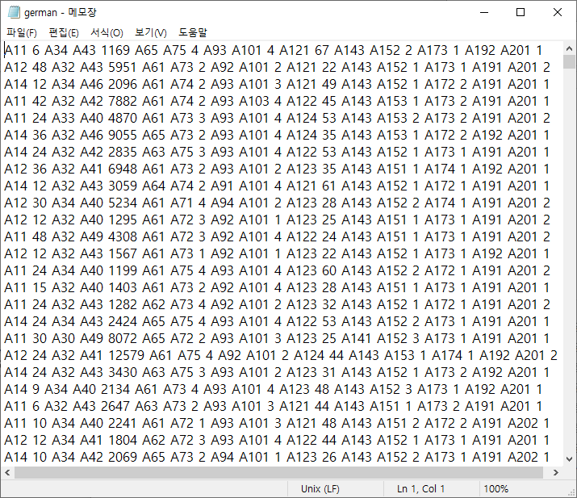
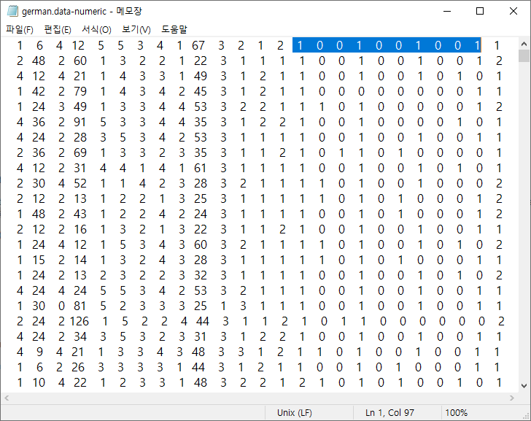
Introduction
Compare A and B
A (left) and B (right)

Slide 4
Attribute Description
Attribute 1: (qualitative) Status of existing checking account A11 : ... < 0 DM A12 : 0 <= ... < 200 DM A13 : ... >= 200 DM / salary assignments for at least 1 year A14 : no checking account Attribute 2: (numerical) Duration in month Attribute 3: (qualitative) Credit history A30 : no credits taken/ all credits paid back duly A31 : all credits at this bank paid back duly A32 : existing credits paid back duly till now A33 : delay in paying off in the past A34 : critical account / other credits existing (not at this bank) Attribute 4: (qualitative) Purpose A40 : car (new) A41 : car (used) A42 : furniture/equipment A43 : radio/television A44 : domestic appliances A45 : repairs A46 : education A47 : (vacation - does not exist?) A48 : retraining A49 : business A410 : others

Slide 5
Attribute Description
Attribute 5: (numerical) Credit amount Attibute 6: (qualitative) Savings account/bonds A61 : ... < 100 DM A62 : 100 <= ... < 500 DM A63 : 500 <= ... < 1000 DM A64 : .. >= 1000 DM A65 : unknown/ no savings account Attribute 7: (qualitative) Present employment since A71 : unemployed A72 : ... < 1 year A73 : 1 <= ... < 4 years A74 : 4 <= ... < 7 years A75 : .. >= 7 years Attribute 8: (numerical) Installment rate in percentage of disposable income Attribute 9: (qualitative) Personal status and sex A91 : male : divorced/separated A92 : female : divorced/separated/married A93 : male : single A94 : male : married/widowed A95 : female : single

Slide 6
Attribute Description
Attribute 10: (qualitative) Other debtors / guarantors A101 : none A102 : co-applicant A103 : guarantor Attribute 11: (numerical) Present residence since Attribute 12: (qualitative) Property A121 : real estate A122 : if not A121 : building society savings agreement/ life insurance A123 : if not A121/A122 : car or other, not in attribute 6 A124 : unknown / no property Attribute 13: (numerical) Age in years Attribute 14: (qualitative) Other installment plans A141 : bank A142 : stores A143 : none Attribute 15: (qualitative) Housing A151 : rent A152 : own A153 : for free

Slide 7
Attribute Description
Attribute 16: (numerical) Number of existing credits at this bank Attribute 17: (qualitative) Job A171 : unemployed/ unskilled - non-resident A172 : unskilled - resident A173 : skilled employee / official A174 : management/ self-employed/ highly qualified employee/ officer Attribute 18: (numerical) Number of people being liable to provide maintenance for Attribute 19: (qualitative) Telephone A191 : none A192 : yes, registered under the customers name Attribute 20: (qualitative) foreign worker A201 : yes A202 : no

